Slide 1
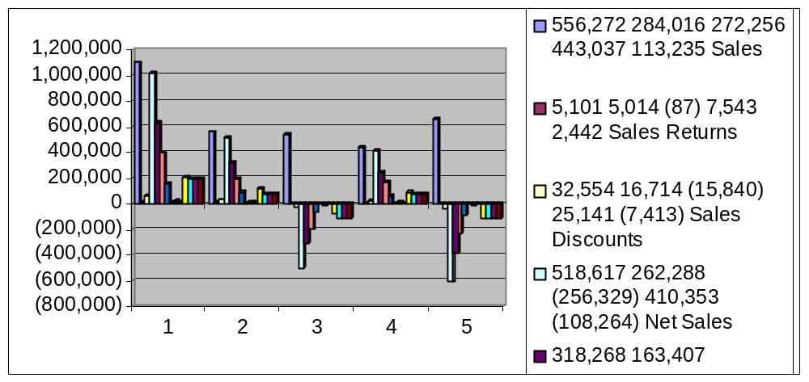
2003 Variance Analysis

